Slide 1

IT-648: IT Risk Management
Week 1
Sonja Streuber

Slide 2
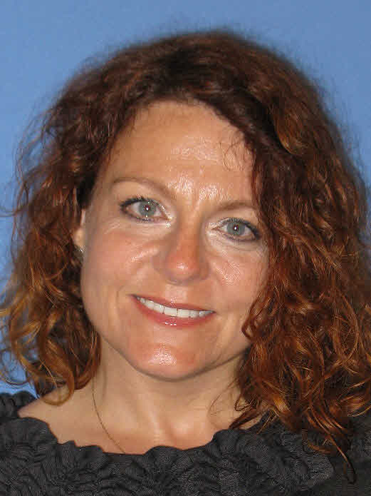
Welcome to IT-648
Learning Objectives
At the end of the course, students will be able to effectively respond to information security concerns in a professional environment, specifically to:
Evaluate an organization’s IT security posture and risk profile, incl. performing appropriate vulnerability scans
Identify, select, and implement an appropriate controls framework to reduce organizational IT risk, incl. hardware and software access and authorization management
Perform crucial system administration tasks to “harden” servers and other network equipment
Develop an appropriate incident handling and analysis strategy
ATTENDANCE REQUIRED for onsite students!
MWF 12:30-1:20 in ASB 236 and on Blackboard
sonja.streuber@valpo.edu * Google Hangouts: MTWRF 12-1
212 Gellersen: F 12-1

Slide 3
Welcome to IT-648
Required Materials
Agrawal, Manish (2014), Information Security and IT Risk Management. Wiley.
A laptop computer (Windows, Mac, or Linux) with administrator permissions.
Oracle VirtualBox, available at https://www.virtualbox.org/ .
CentOS Virtual Machine download (2.8 GB) AND CentOS MD5 SUM download (1 KB) from http://bcs.wiley.com/he-bcs/Books?action=resource&bcsId=8851&itemId=1118335899&resourceId=34893
Required Work/ Grading
Required | Pts Each | Total
Discussions and Responses | 10 | 150
Weekly Lab Assignments (Team) | 50 | 750
Course Final | 100 | 100
TOTAL POINTS POSSIBLE |  | 1000
Letter Grade Conversion:
>93%: A 90-93%: A- 87-90%: B+ 83-87%: B 80-83%: B- 77-80%: C+
73-77%: C 70-73%: C- <70%: F
Submit all assignments in Blackboard—NO EMAILS.
Late assignments lose 50% of their grade.

Slide 4
Welcome to IT-648
Weekly Structure to get the most out of this course:
Monday: Prepare for the discussion of the previous week’s lab assignment (onsite) or review assignment feedback (online); read the assigned book chapter for the week; review the new lab & prepare to ask questions
Tuesday: Keep reviewing the materials posted on Blackboard; do the chapter review questions in the book
Wednesday: In-depth discussion of topic for the week with lab (onsite); do the hands-on activity (online); post your discussion post by 11:59 pm CST
Thursday: Review the example case and the example case questions
Friday: Hands-on application of topic for the week; review the design case and be ready to answer the design case questions.
You will need your computer with the Virtual Machine for the book.

Slide 5
Agenda
# | Topic | Reading | Due Saturday 11:59 pm CST on Blackboard
1 | Course Introduction | Agrawal 1 Videos as posted on Blackboard | Friday: Post Sunday: Responses Saturday: LAB_1

Slide 6
Chapter 1
Introduction

Slide 7
Overview
By the end of this week, you will be able to:
Summarize the important developments that led to the current state of the information security industry
Define key terms used in information security
Describe in broad outlines the procedures used in the industry to maintain information security
Perform a simple software audit with an online vulnerability scanner
Reverse engineer a simple virus cloaking mechanism

Slide 8
Discussion 1
POST (DUE FRI 11:59 pm CST): Every course is much better when you are having fun! And having fun means getting to know the people who are undertaking this educational journey with you. So, please share with us an introduction of who you are, where you come from, where you are currently located, and why you are taking such a hard and intense course during the winter/ spring, when you could be lounging on a couch in front of a fireplace with a good novel and a cup of coffee in your hand.
Then get to work:
On the internet, find the homepage of Secunia Online Software Inspector, download the free personal computer app, and perform a scan of your laptop. In your discussion post, describe the results.
RESPONSE (DUE SUN 11:59 pm CST): Respond to two of your peers' posts. List three actions they can take to fix issues that the audit tool has identified.

Slide 9
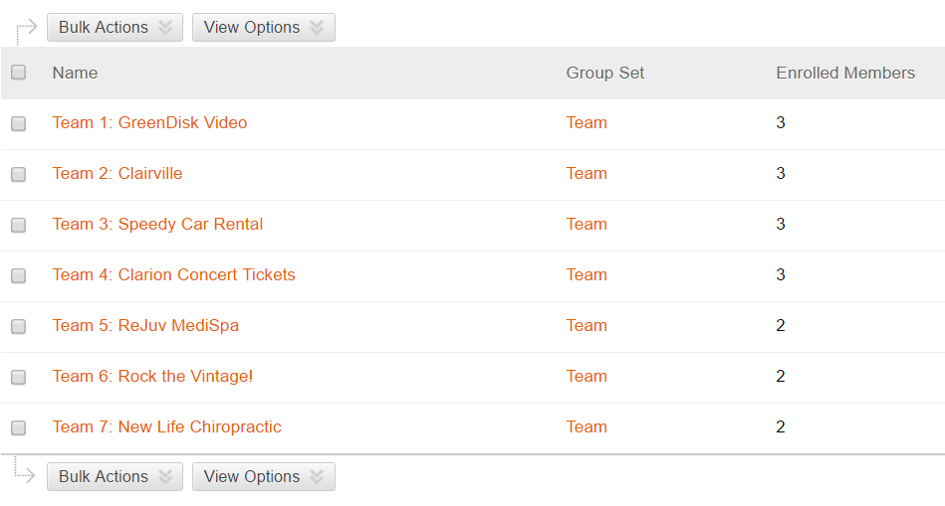
Homework Lab_1
LAB_1: The company you currently work for does not have a CISO. You want this job and decide to demonstrate to the CEO that steganography is real. Use the company logo that you have received and follow the steps on p. 17-21 in our course book to embed secret text in the image. Submit printouts of the original image, the modified image, and a screenshot of the text embedded in the image as in Figure 1.14
Use the files in your assigned group area.
NOTE: Groups may change after the add/ drop deadline.

Slide 10
Summary
By the end of this week, you will be able to:
Summarize the important developments that led to the current state of the information security industry
Define key terms used in information security
Describe in broad outlines the procedures used in the industry to maintain information security
Perform a simple software audit with an online vulnerability scanner
Reverse engineer a simple virus cloaking mechanism

Slide 11
For Next Week
# | Topic | Reading | Due Sunday 11:59 pm CST on Blackboard
2 | System Administration (1): Linux System Installation, Case Studies | Agrawal 2 Videos as posted on Blackboard | LAB_2

